Slide 1

DriverPass System Analysis
Manuel Moran
Notes:
[No speaker notes required for this slide.]

Slide 2

System Requirements
Functional Requirements :
The system shall allow users to browse and purchase packages
The system shall allow admins to disable packages if they’re full
Nonfunctional Requirements:
The system will be optimized for usability
The system will have support for multiple browsers.
Notes:
For the functional requirements
The system will allow customers to browse available packages and purchase the package securely online. After purchase the customer should be able to schedule in-person lesson. The system administrator should be able to manage packages by being able to add, edit, and disable packages as needed.
For the nonfunctional requirements.
The system will be easy to navigate for users. The system will also adapt to different screen sizes and devices. The system will be able to run on multiple internet browsers (Firefox, Safari, Chrome)

Slide 3
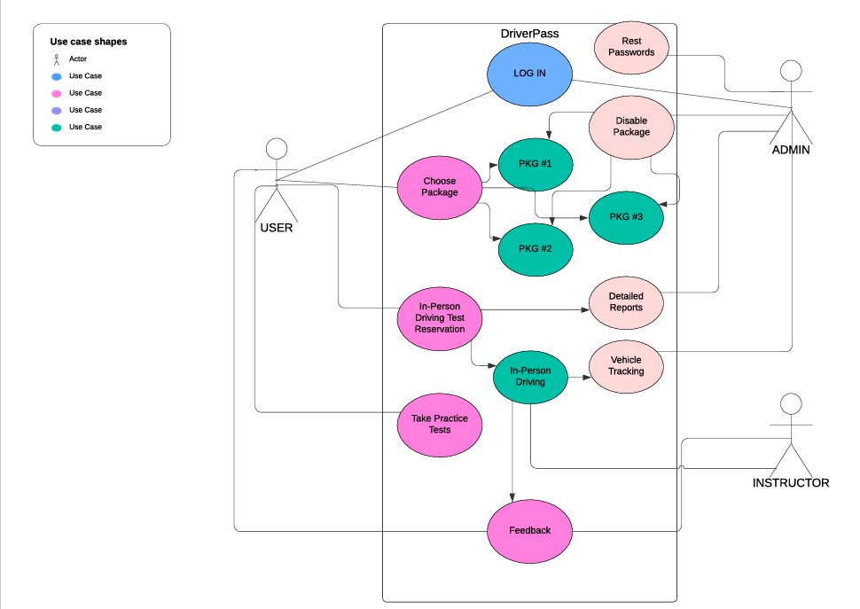
Use Case Diagram
[Insert your use case diagram here.]
Notes:
The use case diagram provides a simple overview of how different user groups interact with the system. It highlights the main actions each group can perform without going into technical details. The diagram shows three distinct user groups: the "user" or customer, the admin, and the instructor. Each group has specific actions they can take within the system. For instance, customers can browse available packages, purchase a desired package, and schedule their in-person driving test.

Slide 4
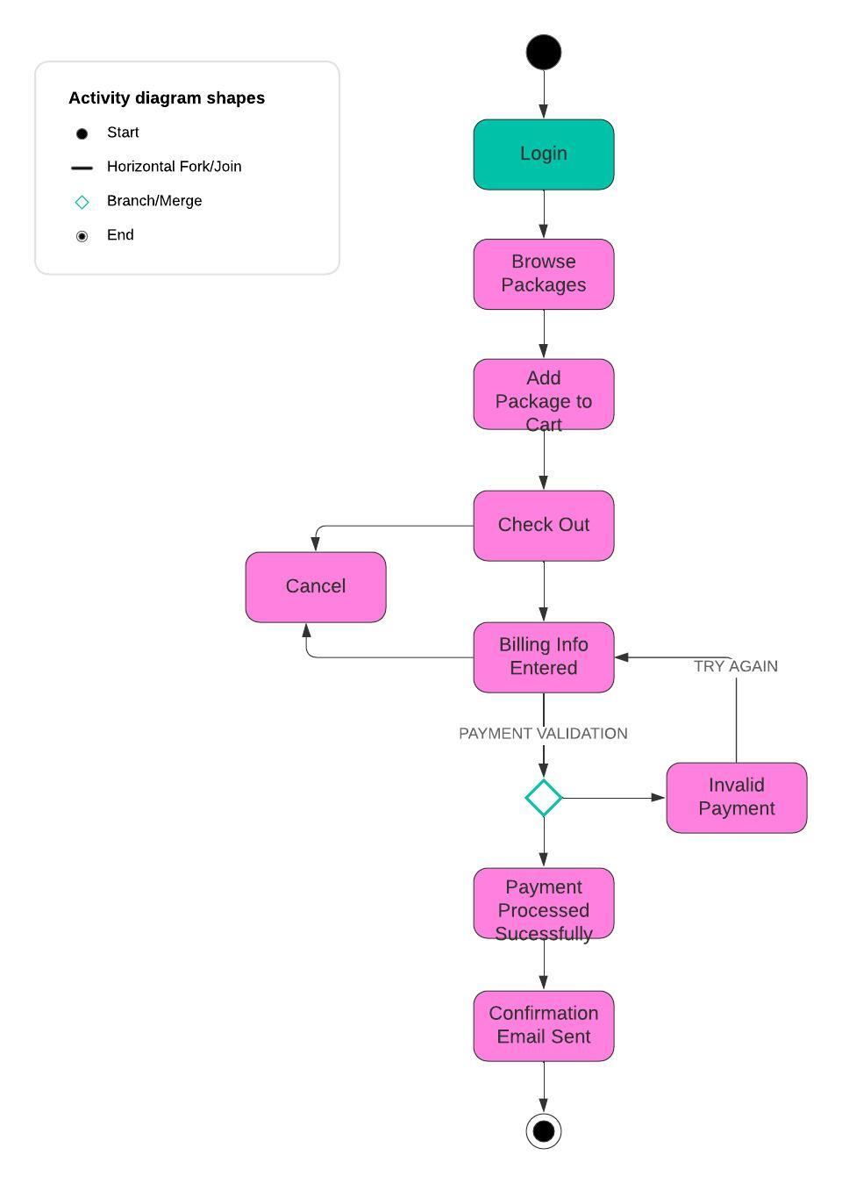
Activity Diagram
Notes:
This activity diagram shows a customer's interaction when purchasing a package within the system. The connecting lines indicate the path that the actions take. It begins with the customer logging in and then browsing available packages. After adding a desired package to their cart, the customer proceeds to checkout and enters their billing information.. The diamond indicates a decision point or different path that the action can take . In this example if the payment is invalid the customer is asked to try again. They’re then redirected back to entering their billing information. Once the payment has been processed successfully the customer receives a confirmation email. The customers interaction with the system then ends.

Slide 5
Security
A complex password consisting of a minimum of 12 characters (letters, numbers, and symbols) would be required to log in. As an added security measure multi-factor authentication (MFA) would be required for both customers and employees to confirm identity.
A secure encrypted connection would be used. (HTTPS as opposed to HTTP) to connect the user to the server.
The users account would be locked out after 3 unsuccessful login attempts. Would use reCAPTCHA as an added measure to deter against brute force attacks.
The system will allow users to reset their passwords if they forget them. User would not be able to reuse the past two passwords.
Notes:
Security is a major concern in the system design, especially when dealing with sensitive information like user data and credit card information. The system will have multiple layers of security features. Which include strong password policies, with optional two-factor authentication. The user’s stored data will be encrypted, will also have a secure encrypted connection to the server

Slide 6
System Limitations
Scheduling limitations. Only 10 vehicles available. Would need to be able to work around this issue. Limited number of packages due to limited cars.
System not accessible to users with disabilities
Notes:
There are two major system limitations. First one being that there are only 10 vehicles available. It might not handle a very large number of new users or appointments smoothly, potentially leading to slowdowns during peak times. Other limitation is that the system might not be fully accessible to people with disabilities.

